Slide 1

Lin Chen’s Presentation

Slide 2
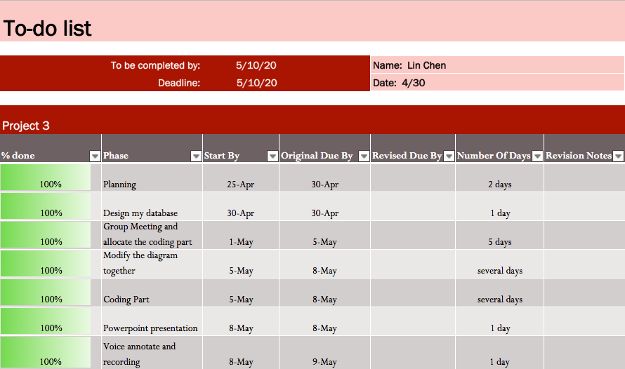
My to-do list

Slide 3
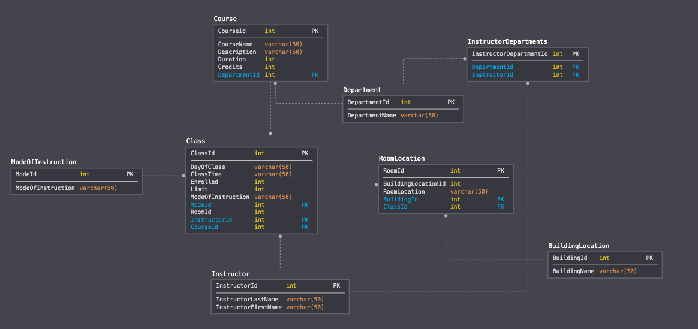
My Design of the database in sqldbm

Slide 4
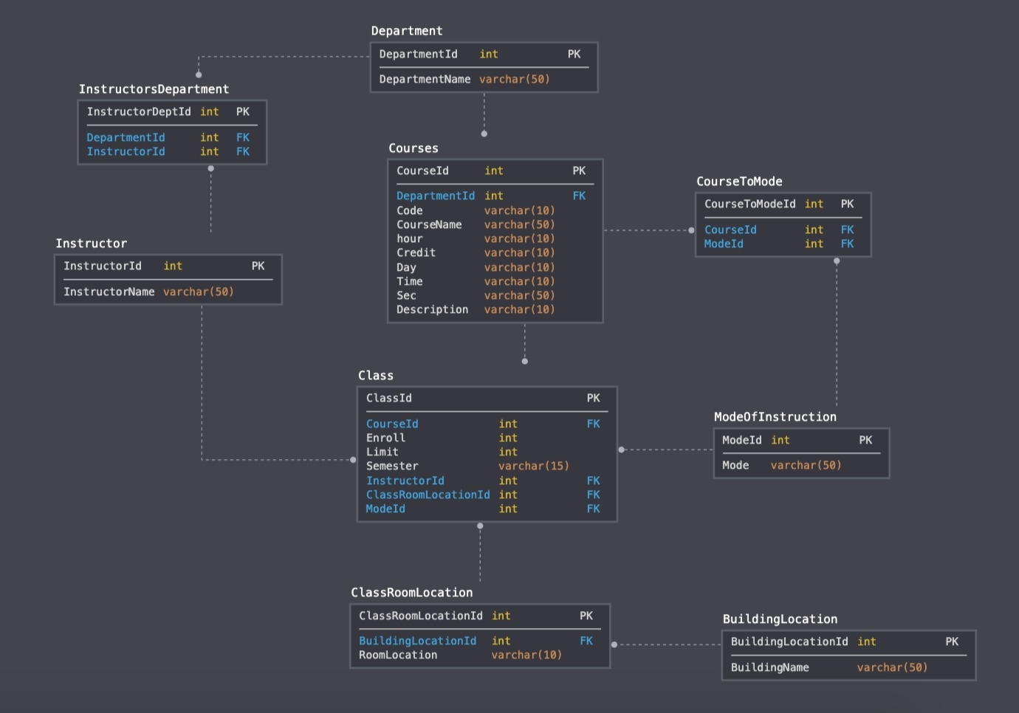
Group Diagram

Slide 5
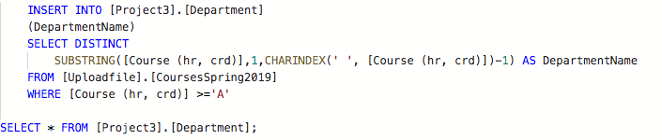
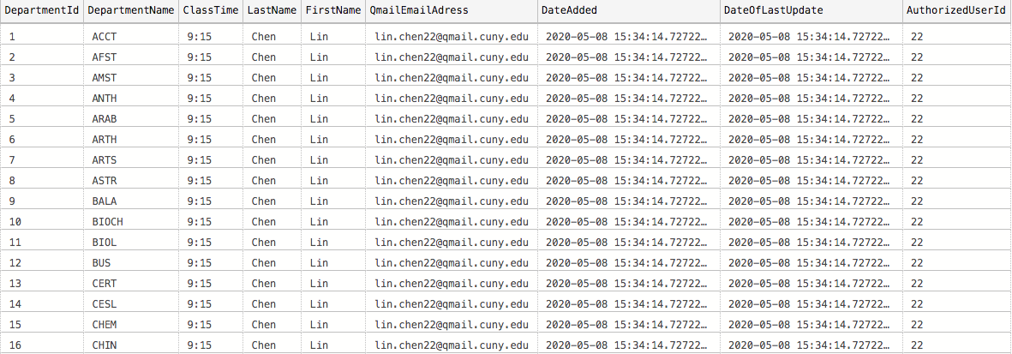
Populating the Department Table

Slide 6
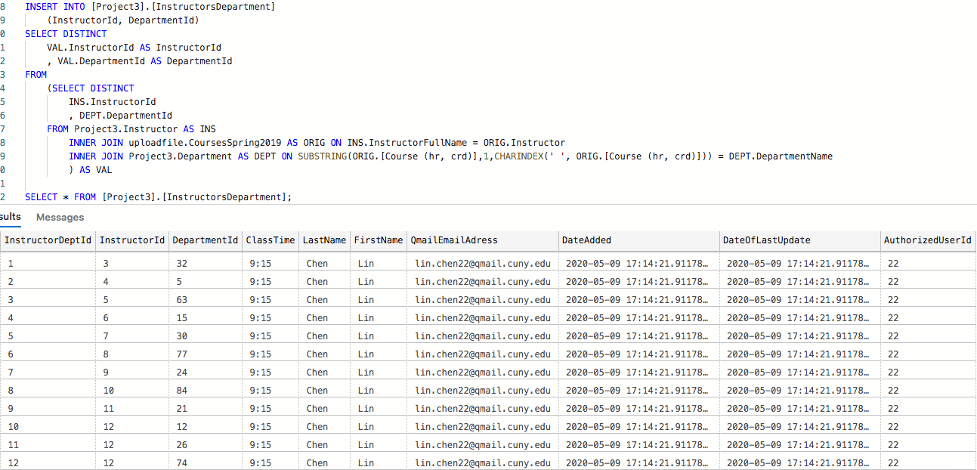
Populating the InstructorsDepartment Table

Slide 7
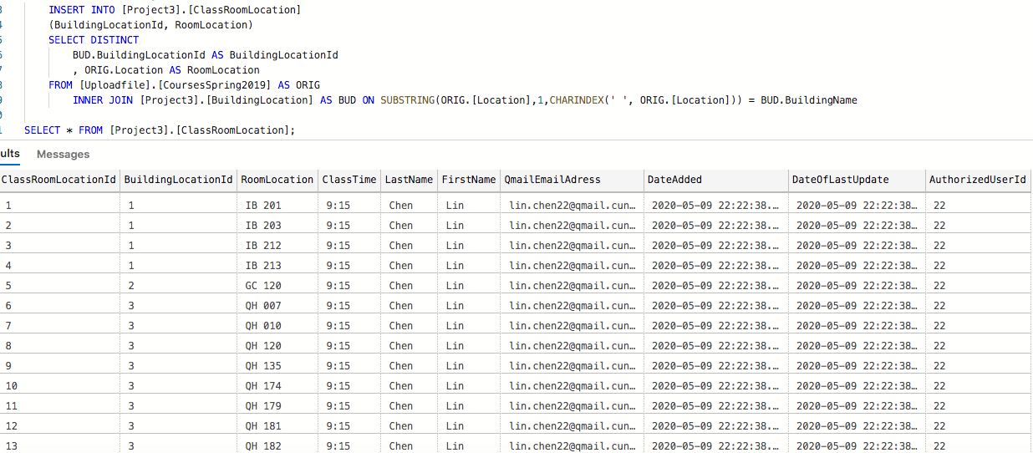
Populating the ClassRoomLocation Table

Slide 8
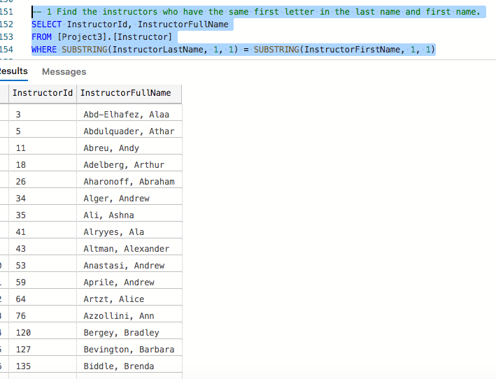
Designed Query 1

Slide 9
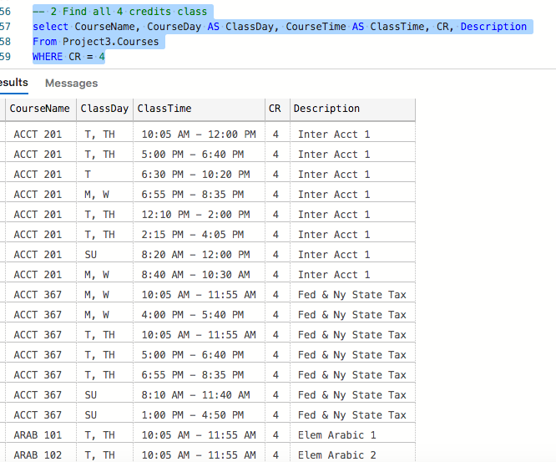
Designed Query 2

Slide 10
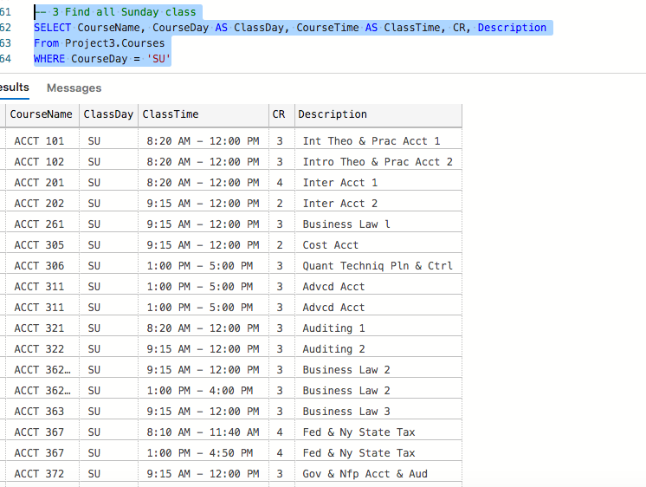
Designed Query 3

